Slide 1



“The more that you read, the more things you will know, the more that you learn, the more places you’ll go.” —Dr. Seuss

Slide 2

^{12th} November,2023
To
Software Development Project Presentation Ceremony

Slide 3
Bangladesh University of Business and Technology
Department of CSE
Intake-49
Section-08
Presented to,
Anusha Aziz
Lecturer
Department of CSE
Bangladesh University of Business and Technology

Slide 4






Bangladesh University of Business and Technology
Department of CSE
Intake-49
Section-08
Mushfiqur Rahman Pulok
ID:21225103525
Md Mehedi Hasan
ID:21225103334
Abdullah Al
Hill Baki
ID:21225103341
Faiza Khandoker Fama
ID:21225103338
Jannatul Ferdous
ID:21225103350

Slide 5
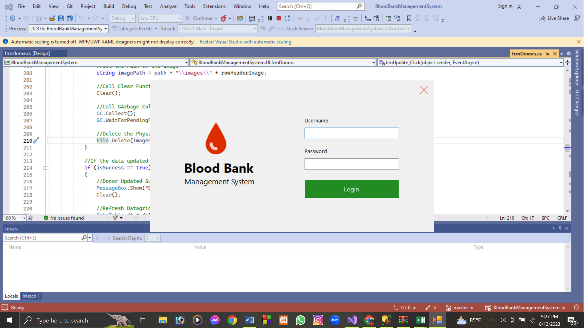

Let's Talk About
"Saving Lives, One Drop at a Time: Empowering Care through Blood Bank Management System."

Slide 6

Content
Introduction
Motivation
Objectives
Features
Interface
Limitations
Future Works
Conclusion

Slide 7




Introduction
A software application designed to efficiently manage the operations of a blood bank or blood donation center.
streamline and automate various tasks related to blood donation and distribution.
ensures the availability of safe and compatible blood products for patients in need.
Need Blood?
What is then?

Slide 8



Motivation
Exclusive Content
Need Blood?
Due to the dengue epidemic in Bangladesh, many people are suffering from anemia and platelet deficiency.
Finding the necessary blood has become difficult.
To address this issue, we are developing a blood bank management system. The system will allow admins to login and update the inventory information of the blood bank, add or remove donor details, and ensure safe blood supply to patients in need.
Powerful Search Functionality
Curated Playlist
Free
Dengue Giveaway
Accessible Multiple Devices
Offline Viewing Options

Slide 9

Objectives
The main objective of this project is to create a desktop-based application that can store information about its users and the donors of the blood bank, also store blood bags and update the details of its inventory

Slide 10


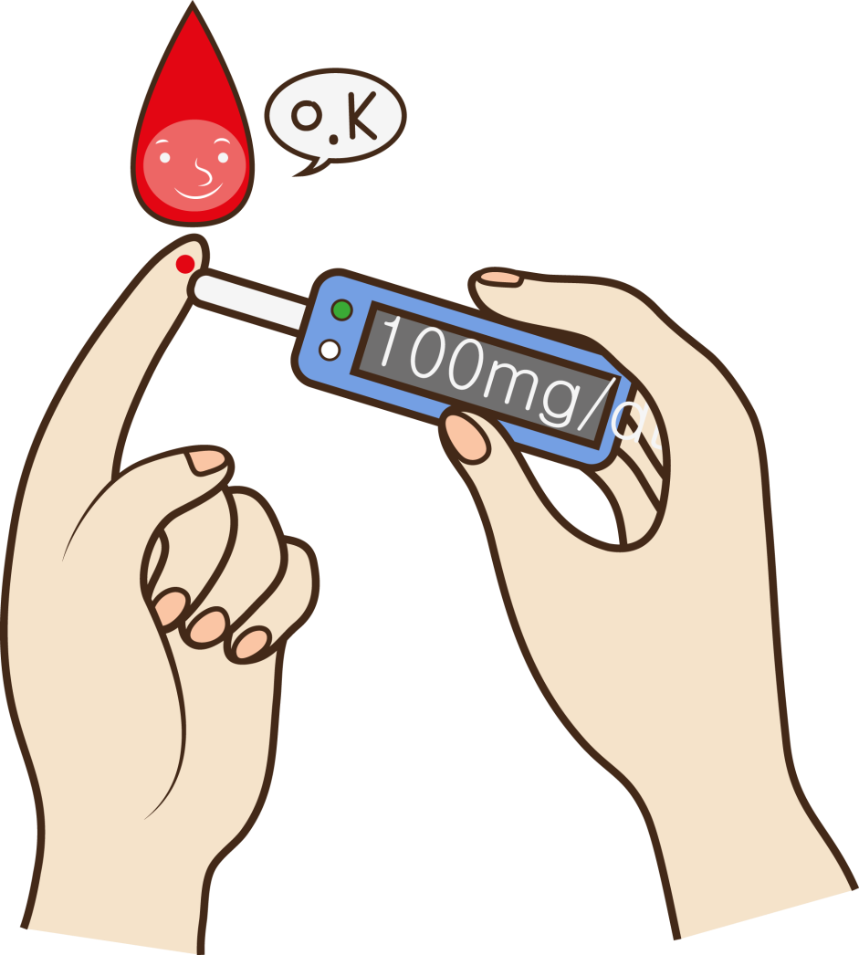
Key features
Login Function
Add, Update and Delete Users
Register Donors and Keep Their Details.
Admins can manage (Add, Update and Delete) Donors
Update stock details

Slide 11
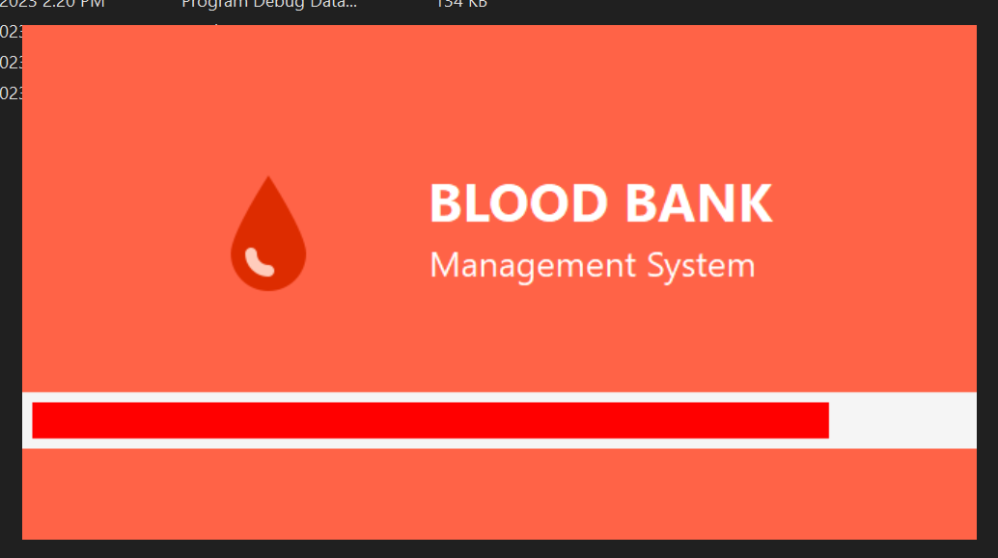
Software Screenshots
Loading interface

Slide 12
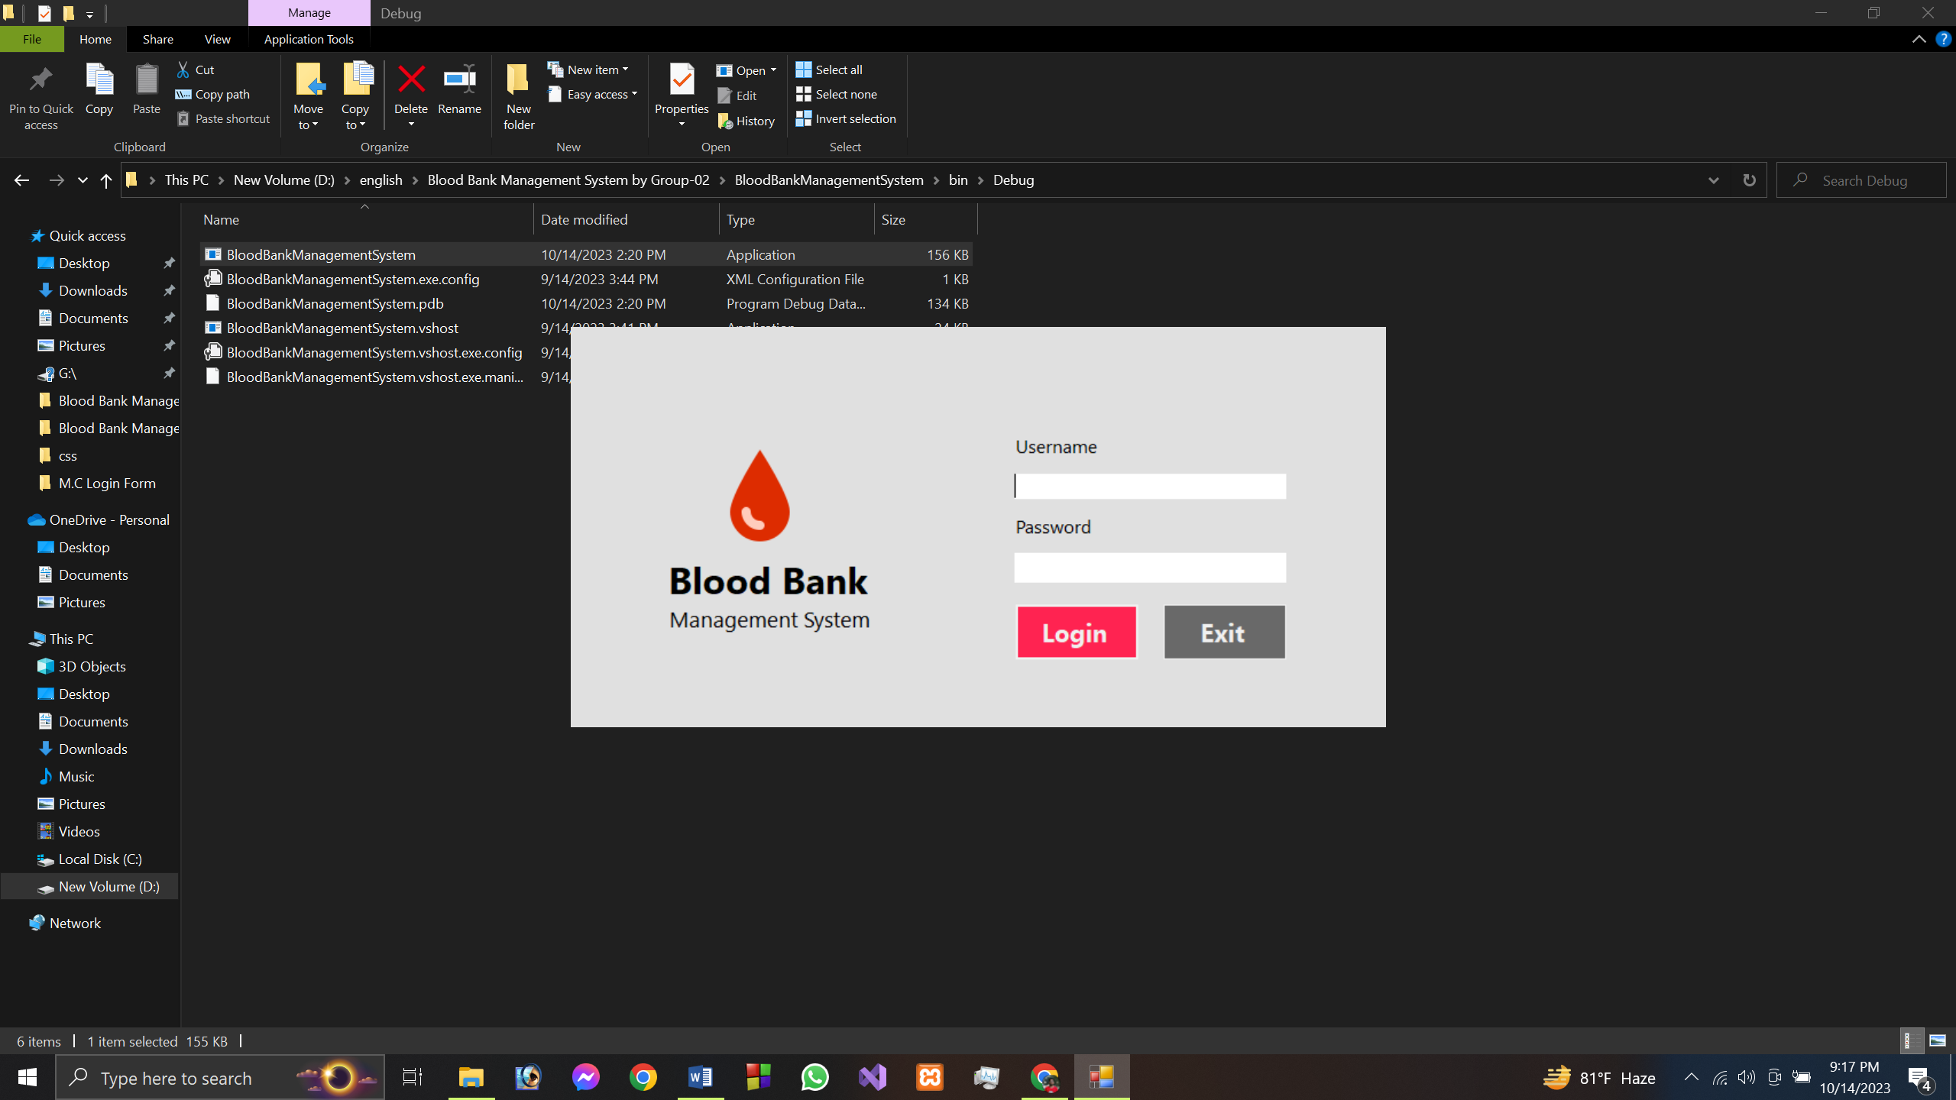
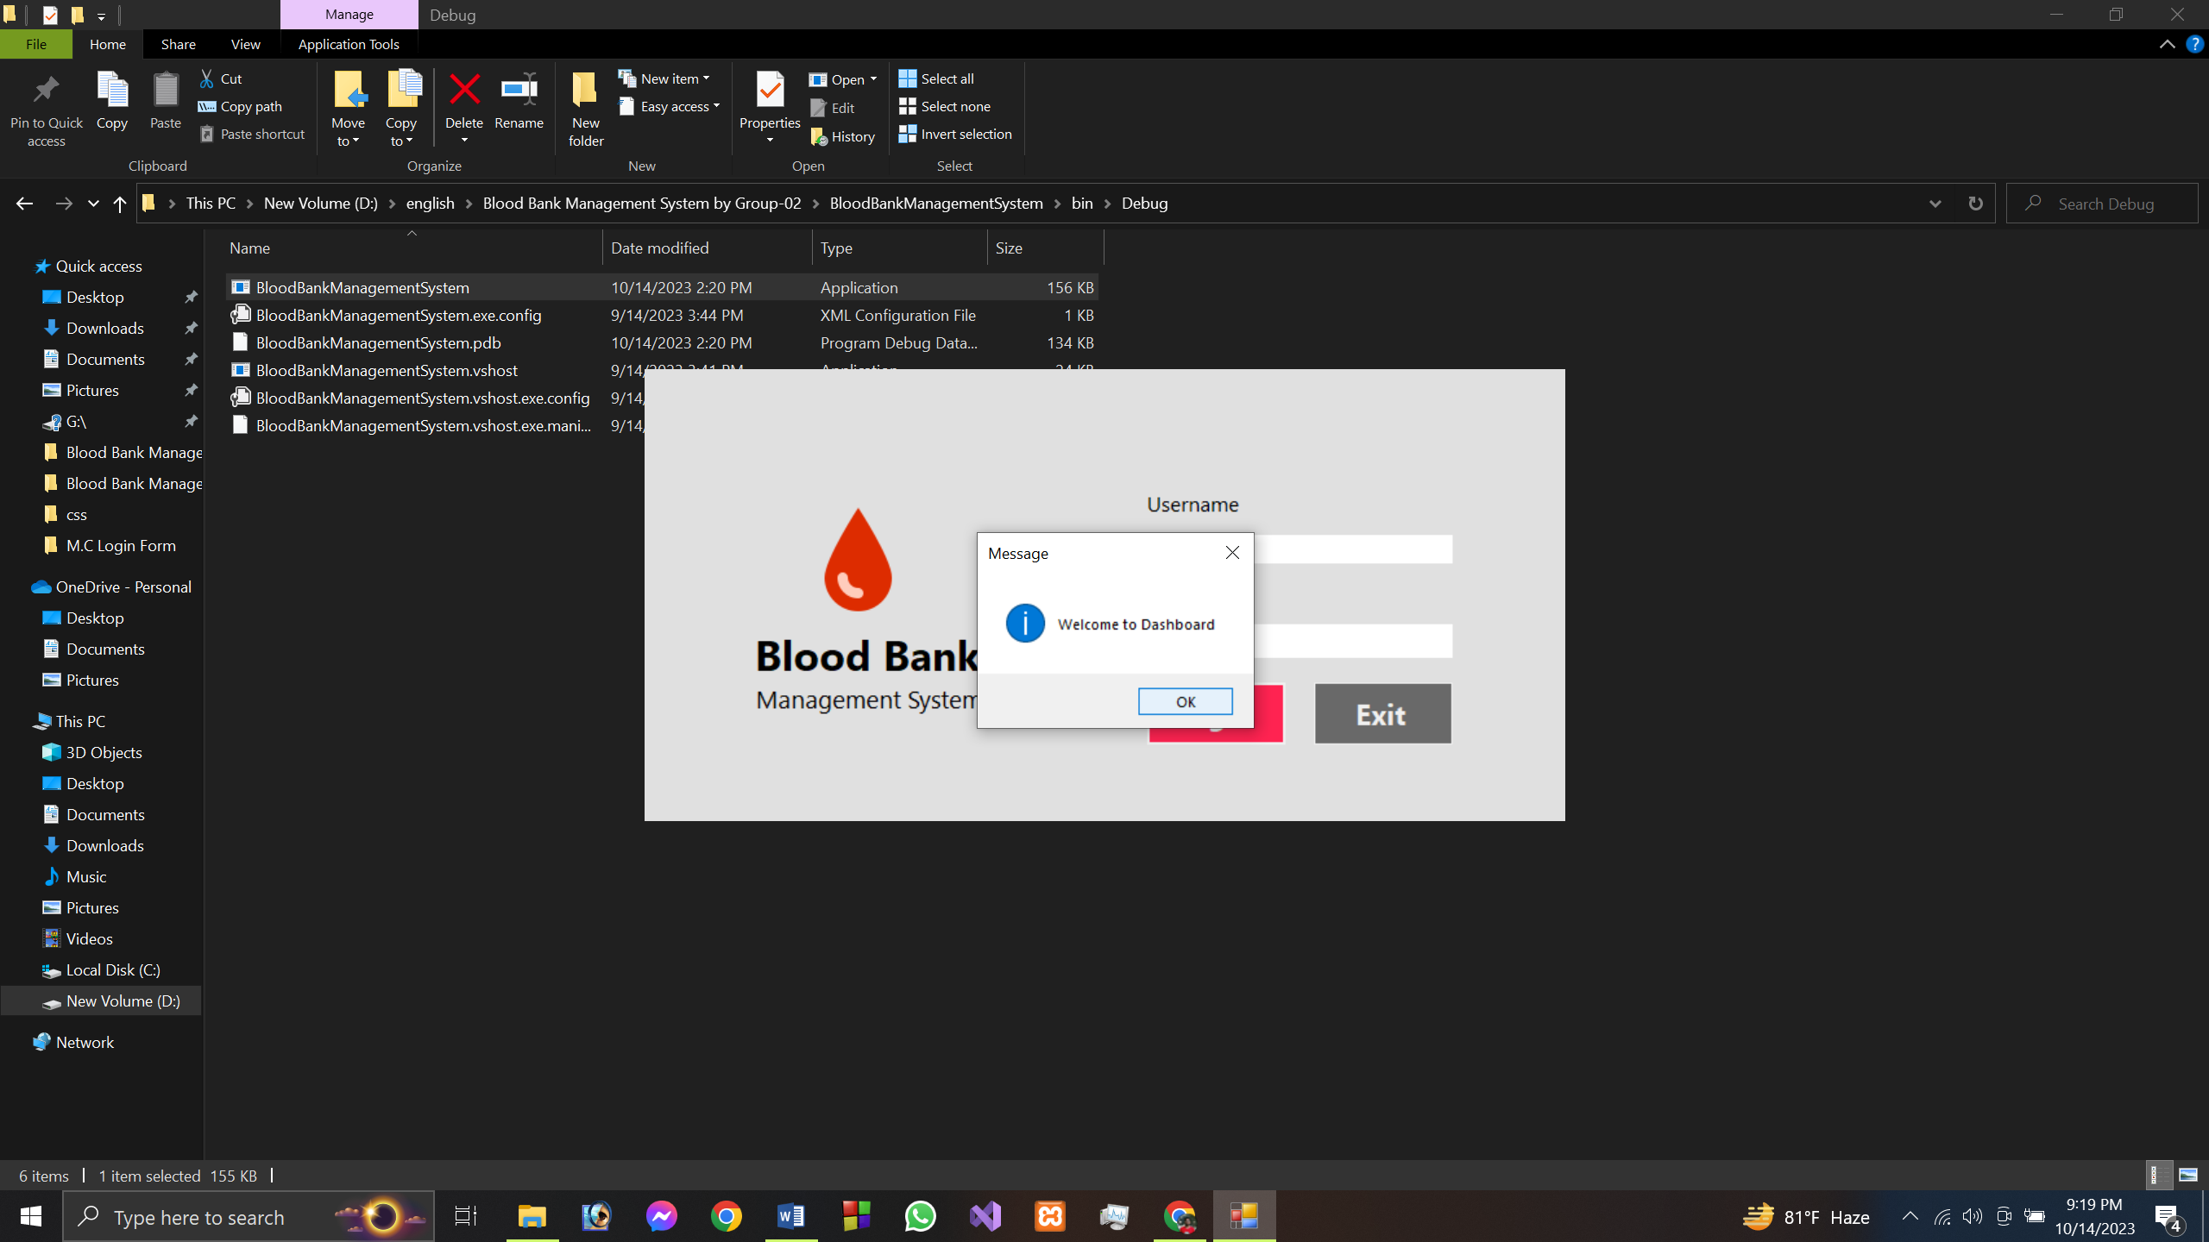
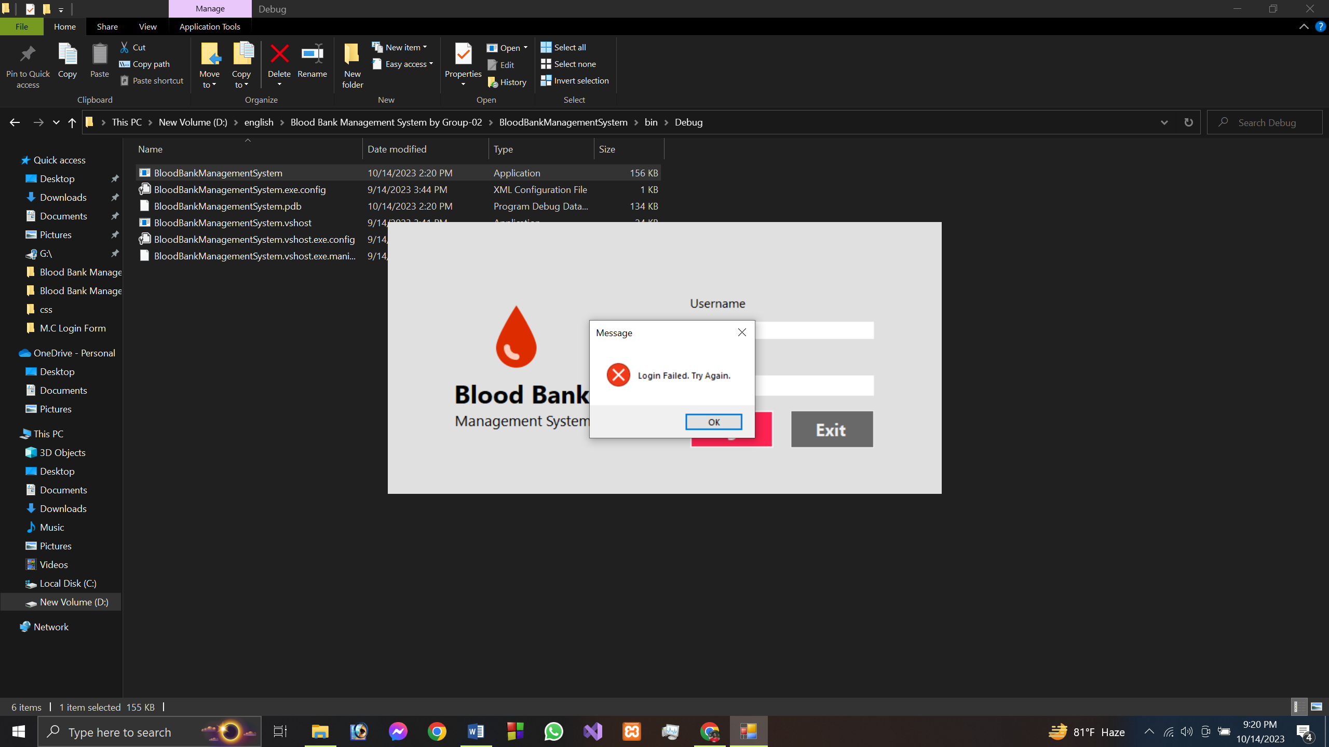
Login panel
Successful login shows welcome message
Wrong password or username shows failed attempt message

Slide 13
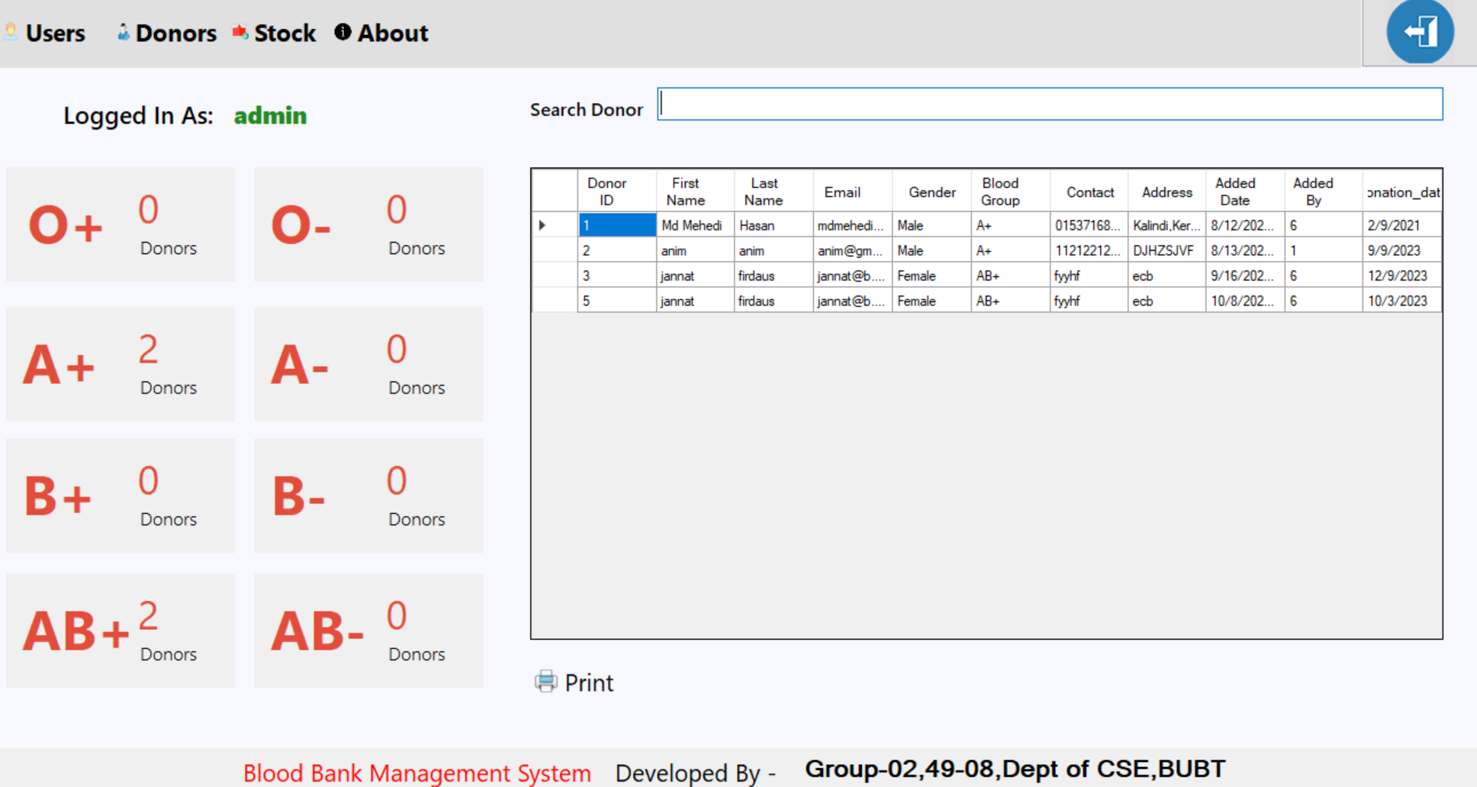
Home Page

Slide 14
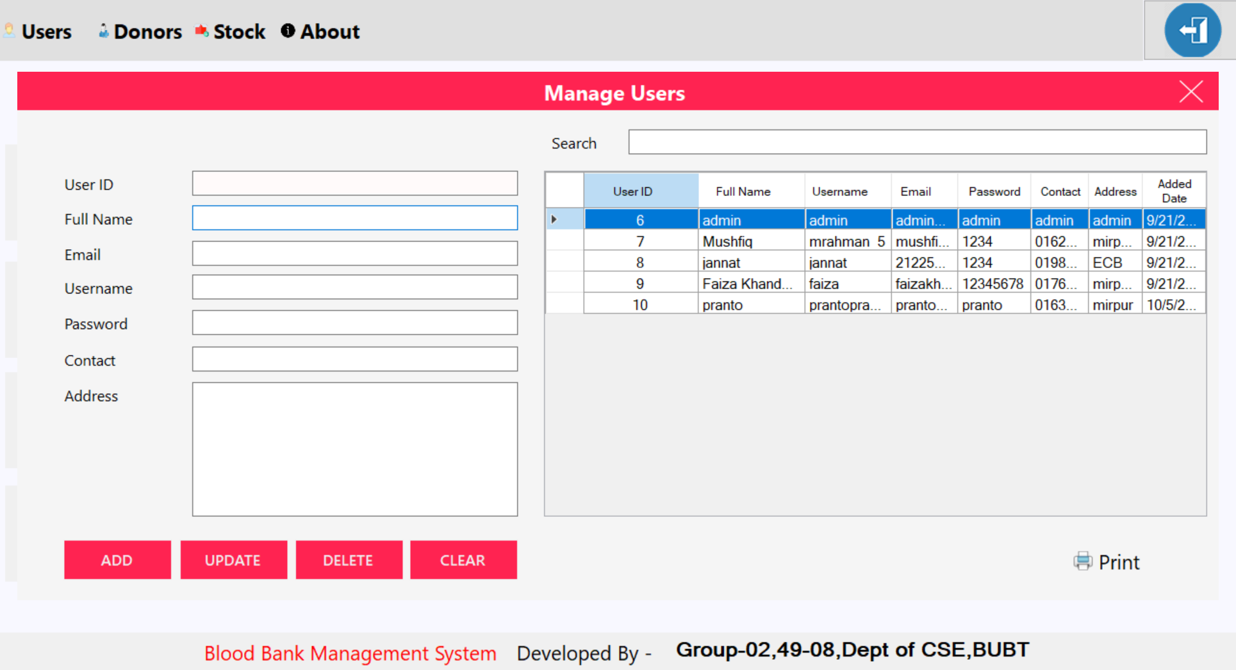
User form

Slide 15
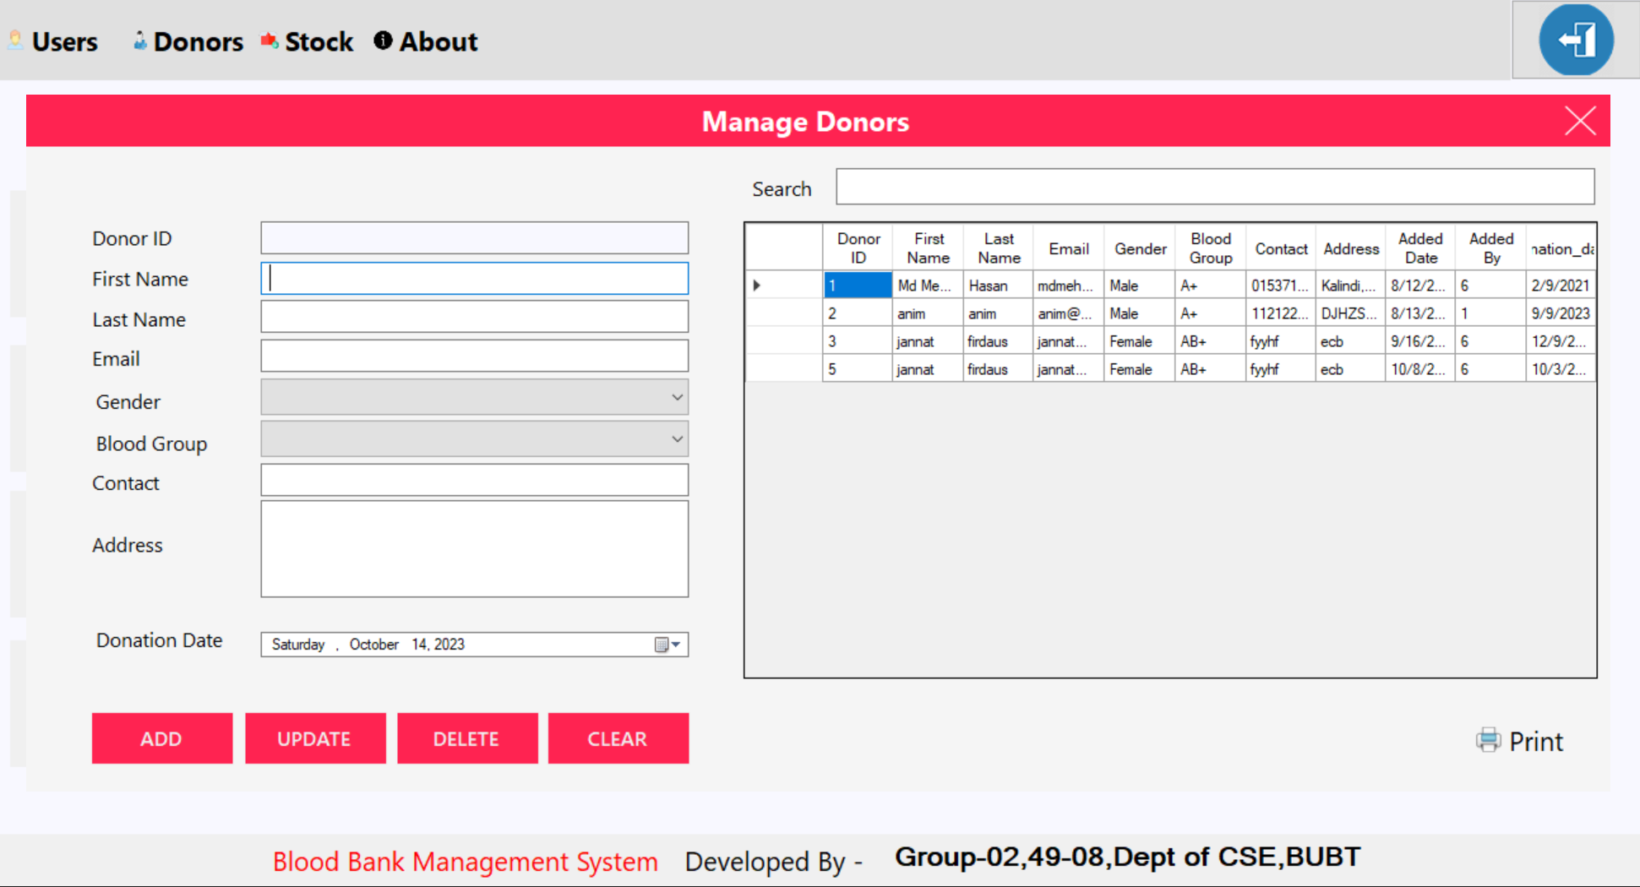
Donors’ form

Slide 16
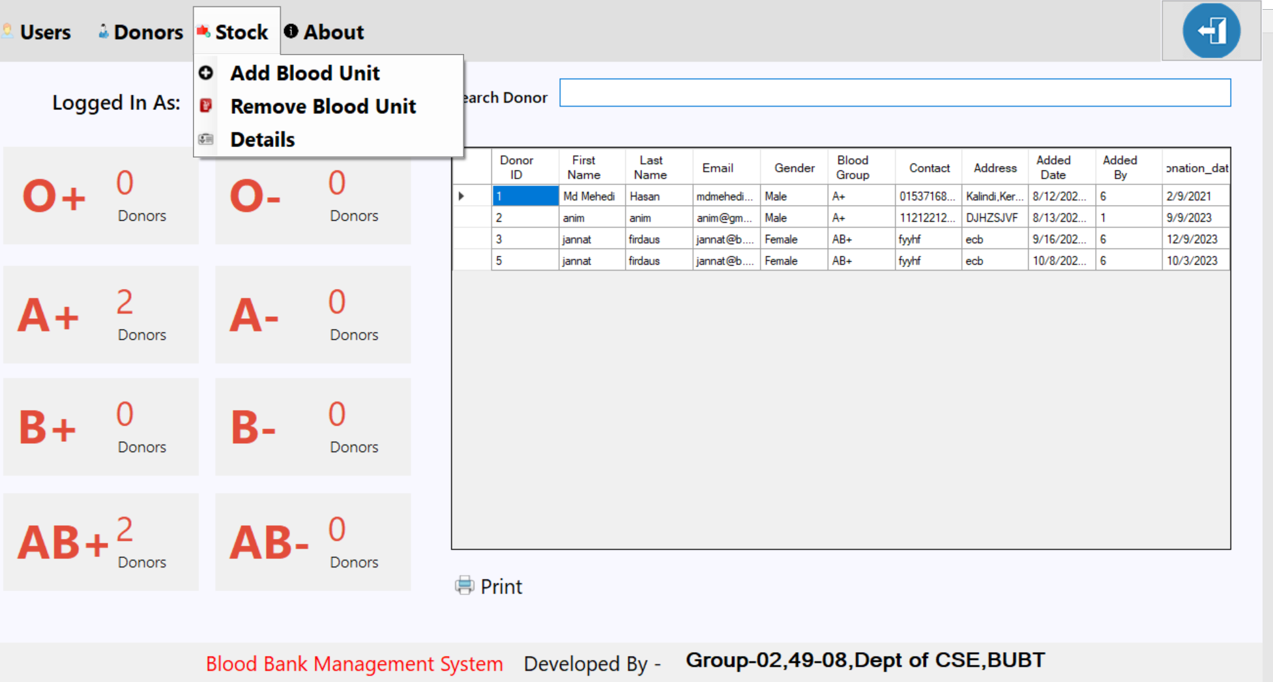
Stock Form

Slide 17
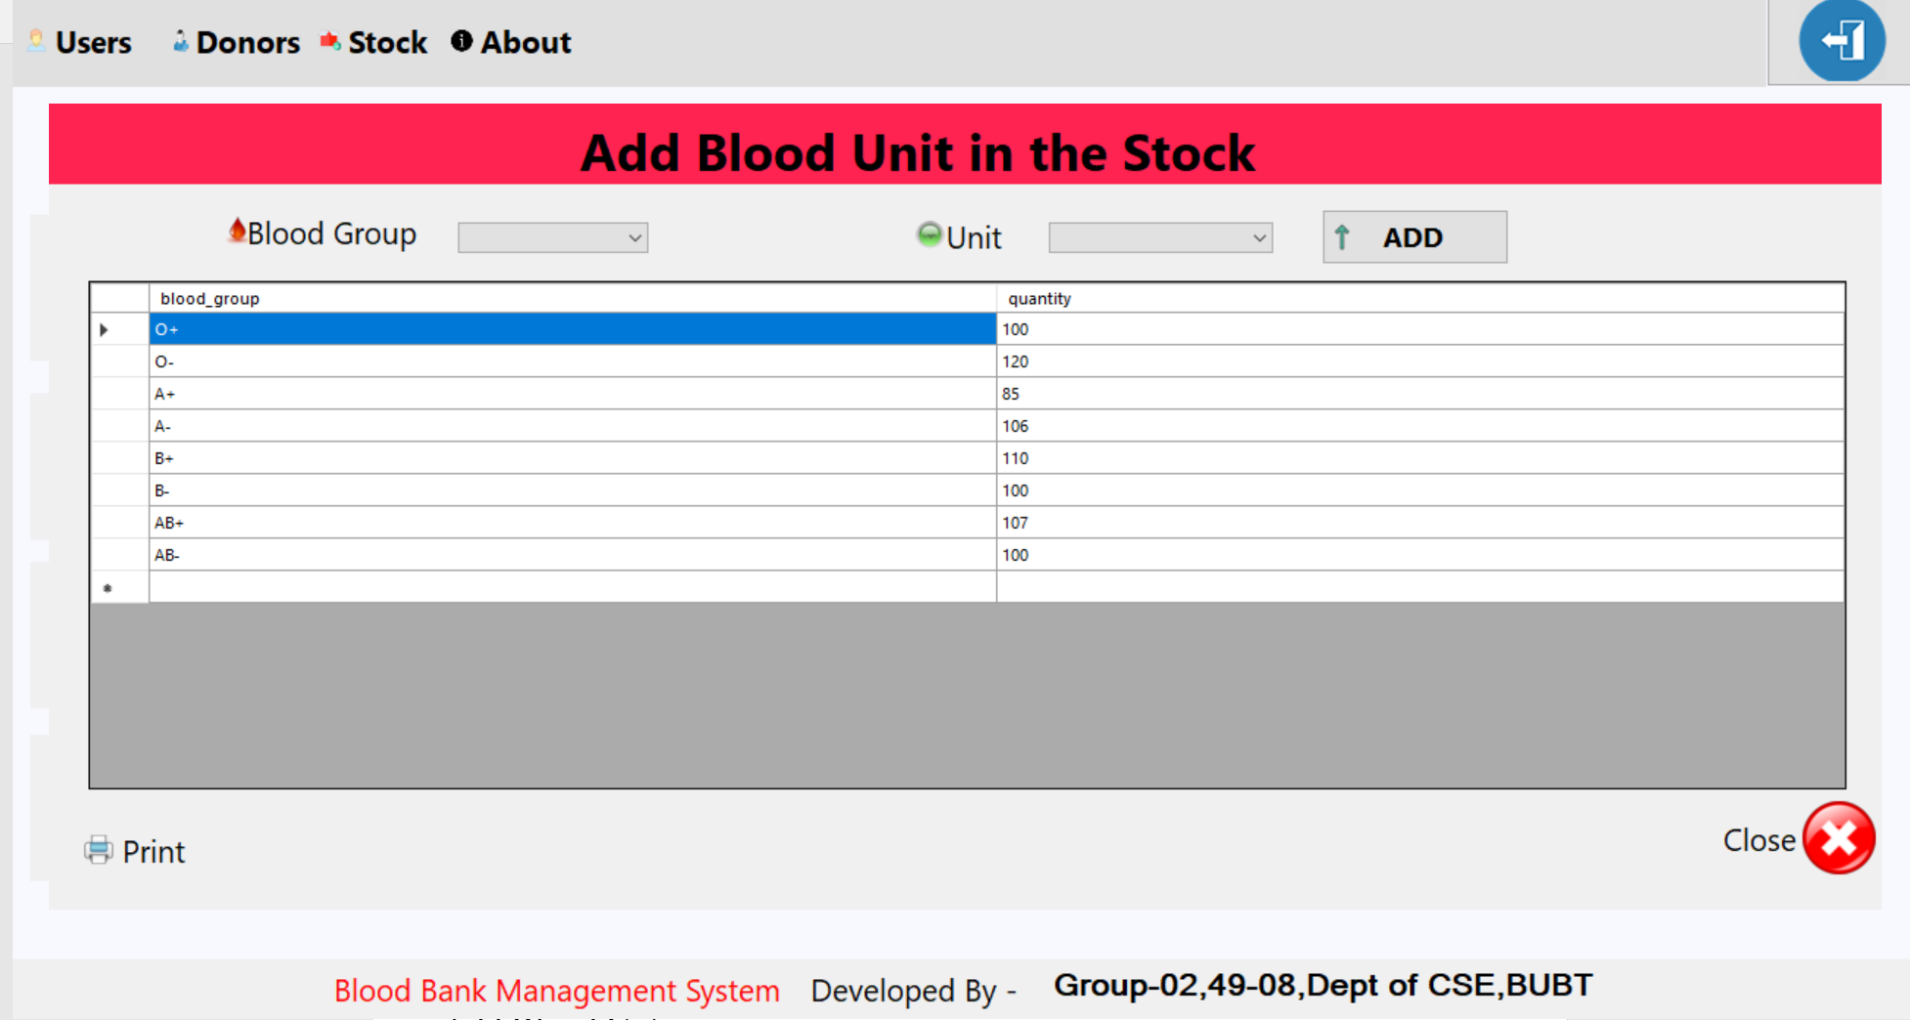
Add Blood Unit

Slide 18
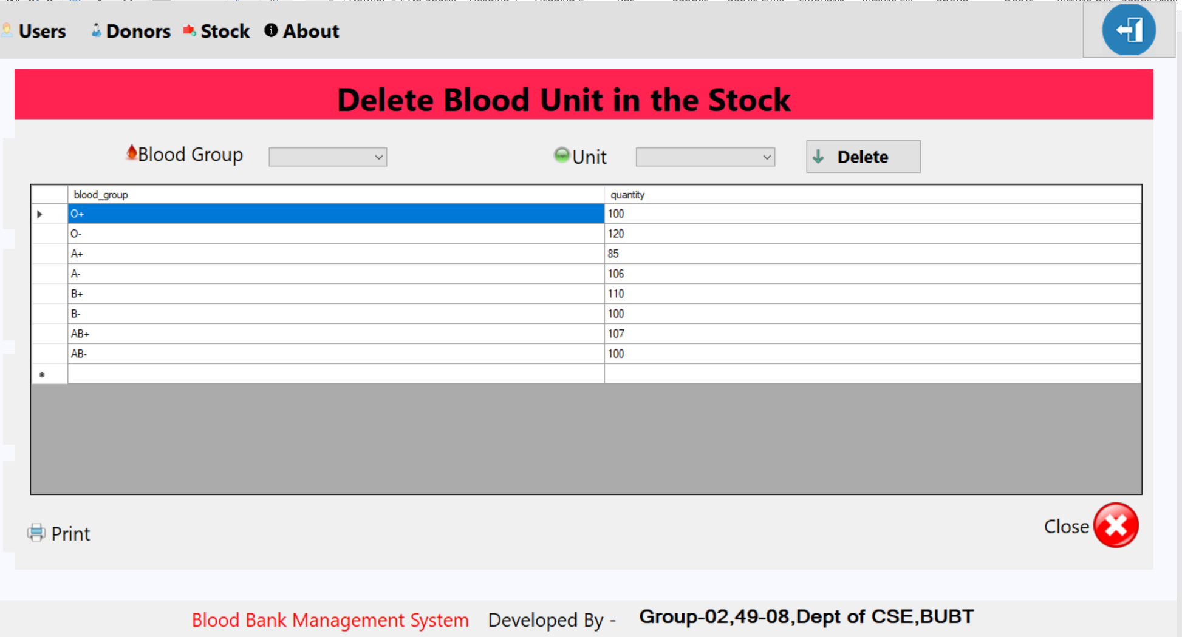
Remove Blood Unit

Slide 19
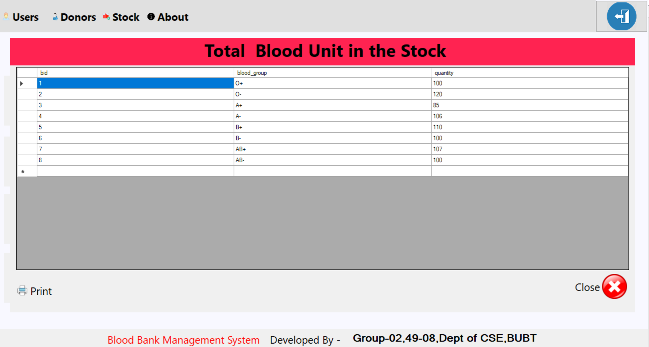
Total Blood Unit

Slide 20
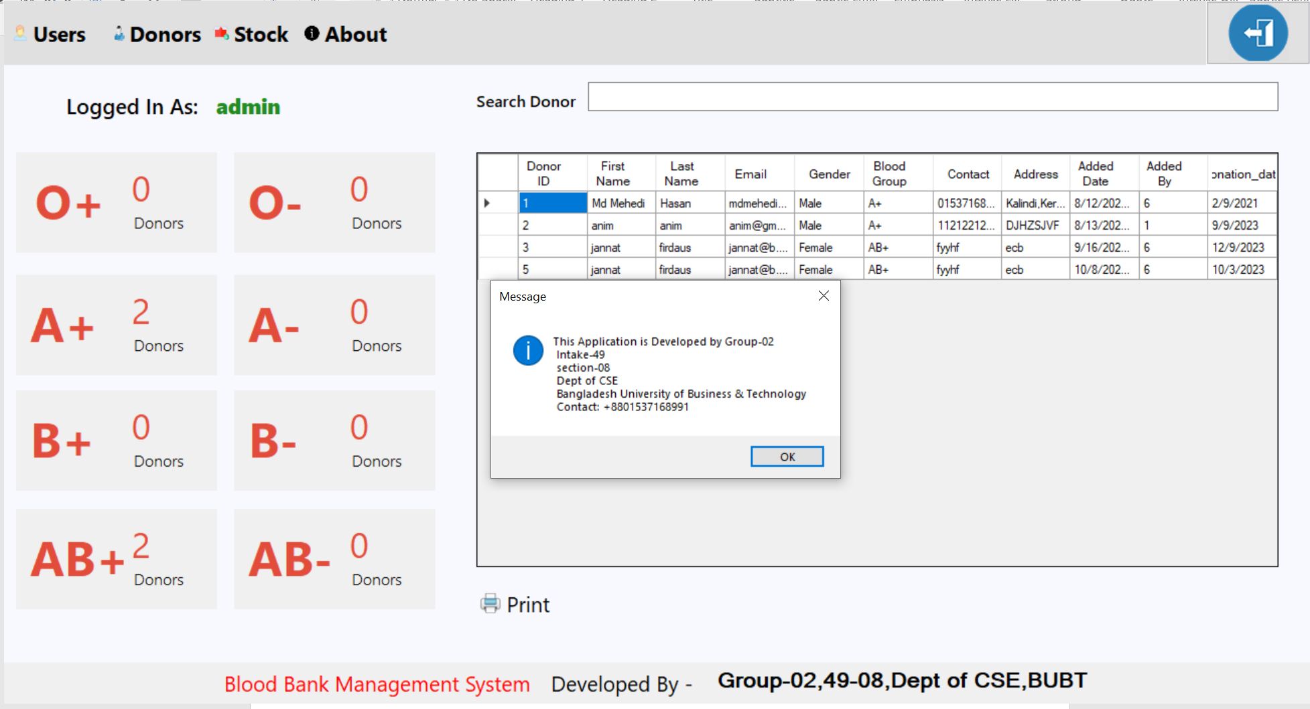
Developers Information

Slide 21
Limitations
New users can not register themselves, it’s the admins who controls the accessibility
Less customization options.
Password recovery is not available for the system.
Donor to donor donate system is not available.

Slide 22


Future works
Enable donor to donor donate system.
Add password recovery system for the users.
More personalization options.

Slide 23

CONCLUSION
Blood bank management system is a useful tool for donors, recipients, and health facilities.
Donors can find where to donate blood easily and conveniently.
Recipients can find where to receive blood transfusions quickly and safely.
Health facilities can manage blood supplies efficiently and effectively.
From the discussion we can easily say that donating or receiving life-saving blood with this system will surely make a difference to those in need.

Slide 24



Slide 25


